Slide 1
Chapter 5
Estimation and Learning

Slide 2
Outline
Parametric Estimation
Maximum Likelihood Estimation
Unbiased Estimates
Bayes Estimation
Non-Parametric Estimation
Histogram Estimation
Parzen Window Estimation
k_{N}-Nearest-Neighbour Estimation

Slide 3
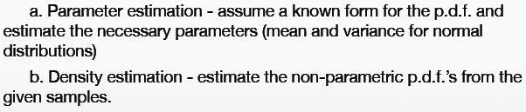
Estimation

Slide 4
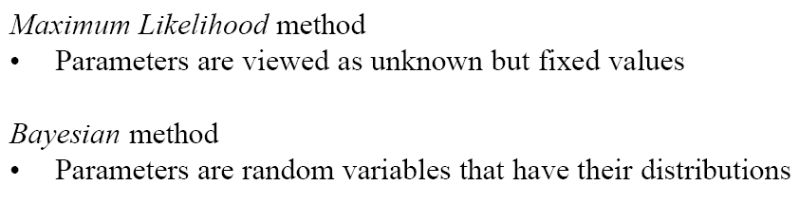
§5.1 Parametric Estimation

Slide 5
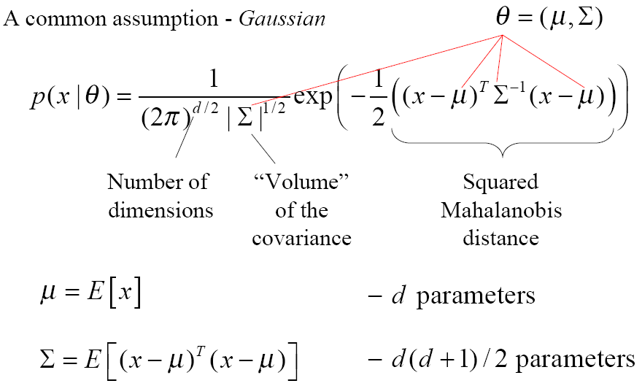
§5.1 Parametric Estimation

Slide 6
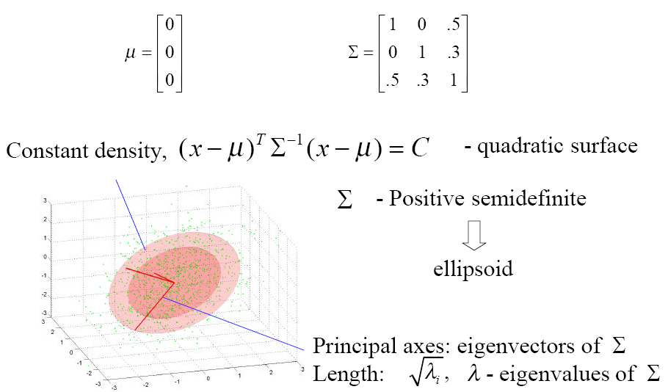
§5.1 Parametric Estimation

Slide 7

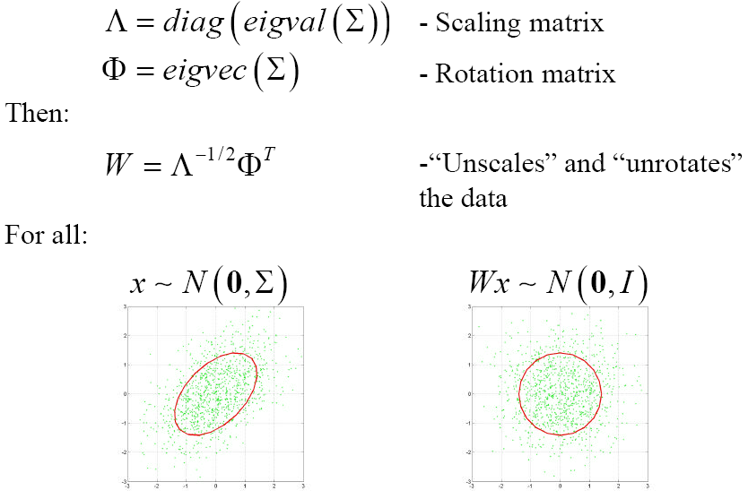
§5.1 Parametric Estimation

Slide 8
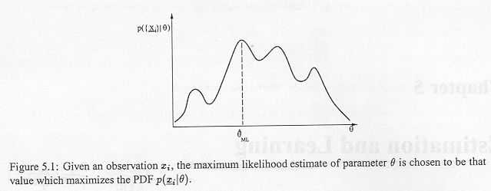
§5.1.1 Maximum Likelihood Estimation

Slide 9
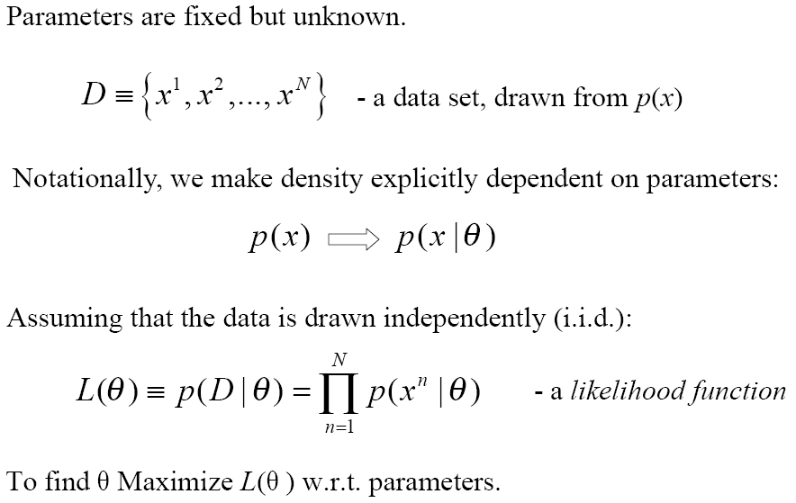
§5.1.1 Maximum Likelihood Estimation

Slide 10
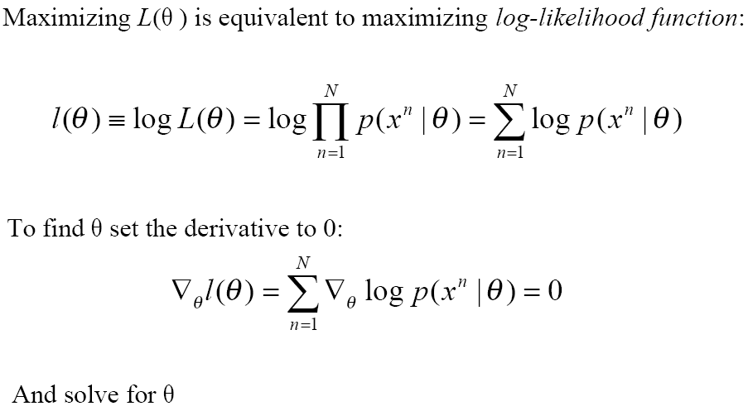
§5.1.1 Maximum Likelihood Estimation

Slide 11


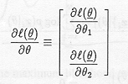
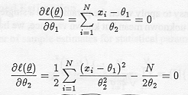
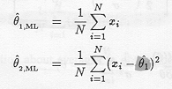
§5.1.1 Maximum Likelihood Estimation

Slide 12
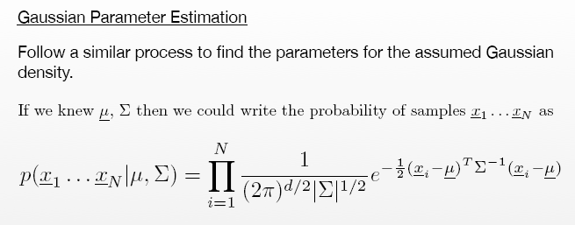
§5.1.1 Maximum Likelihood Estimation

Slide 13
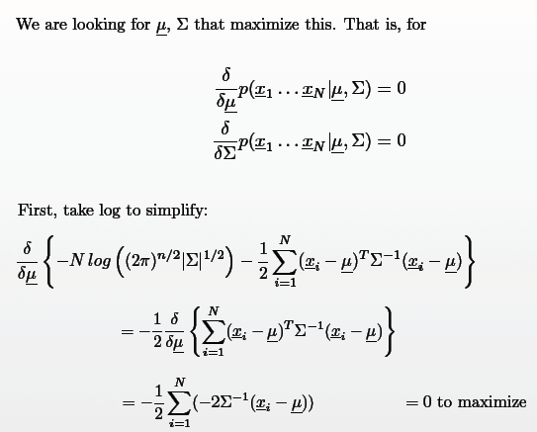
§5.1.1 Maximum Likelihood Estimation

Slide 14
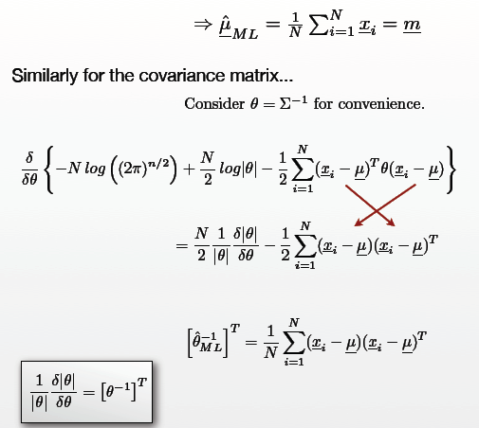
§5.1.1 Maximum Likelihood Estimation

Slide 15
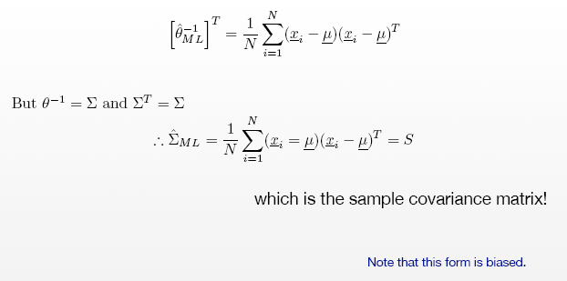
§5.1.1 Maximum Likelihood Estimation

Slide 16





§5.1.1 Maximum Likelihood Estimation

Slide 17
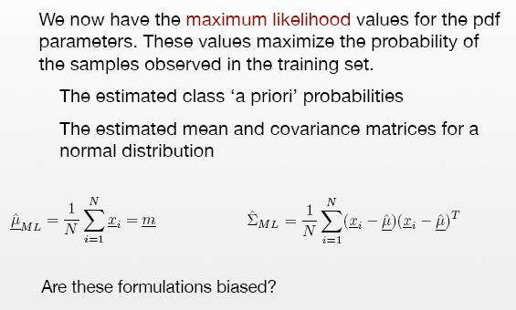
§5.1.2 Unbiased Estimates

Slide 18
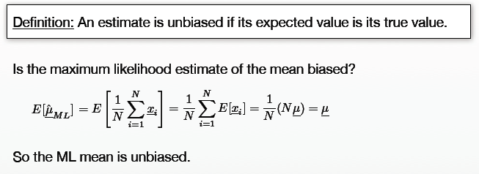
§5.1.2 Unbiased Estimates

Slide 19
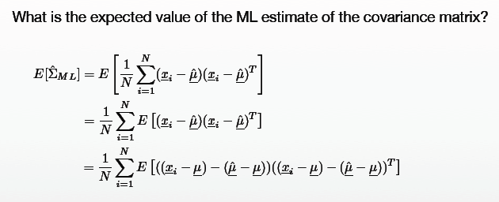
§5.1.2 Unbiased Estimates

Slide 20
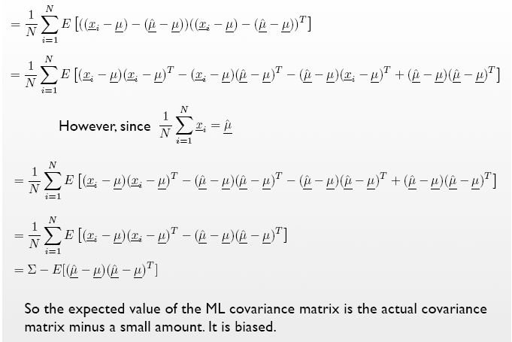
§5.1.2 Unbiased Estimates

Slide 21
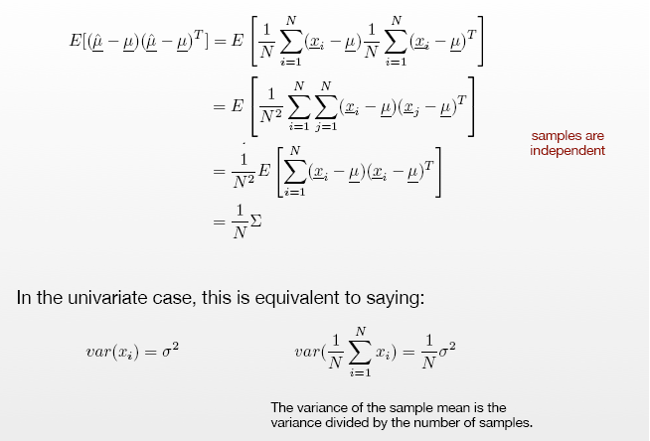
§5.1.2 Unbiased Estimates

Slide 22
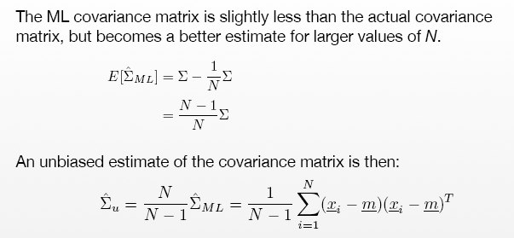
§5.1.2 Unbiased Estimates

Slide 23
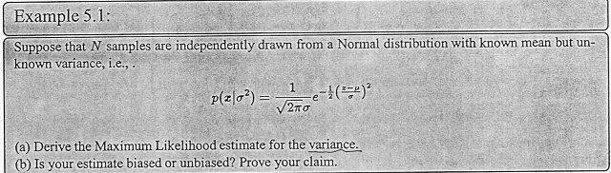
§5.1.2 Unbiased Estimates

Slide 24
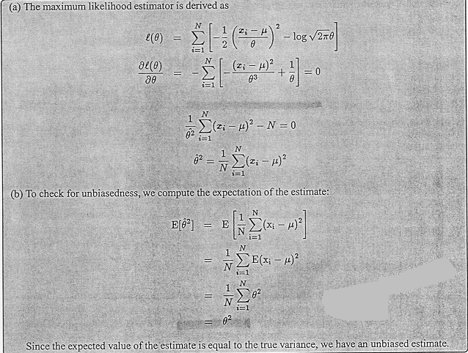
§5.1.2 Unbiased Estimates

Slide 25
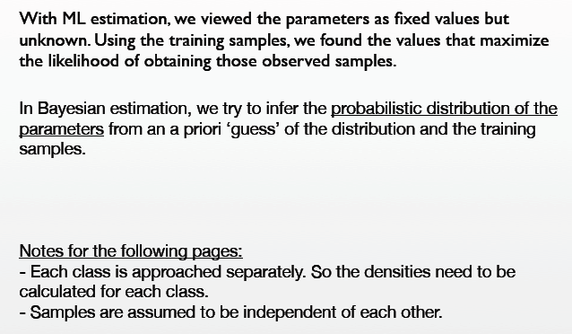
§5.1.3 Bayes Estimation (Bayes Learning)

Slide 26
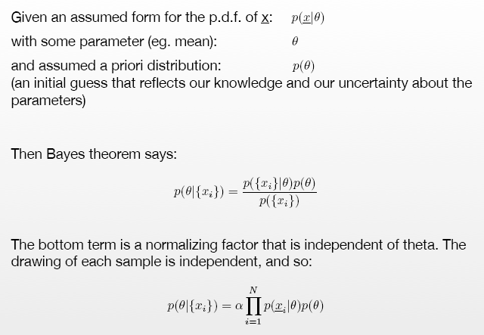
§5.1.3 Bayes Estimation

Slide 27
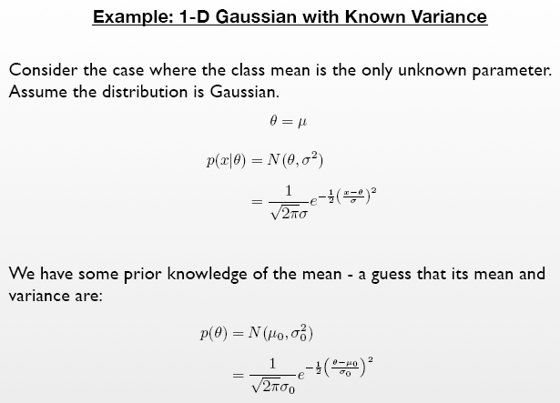
§5.1.3 Bayes Estimation

Slide 28
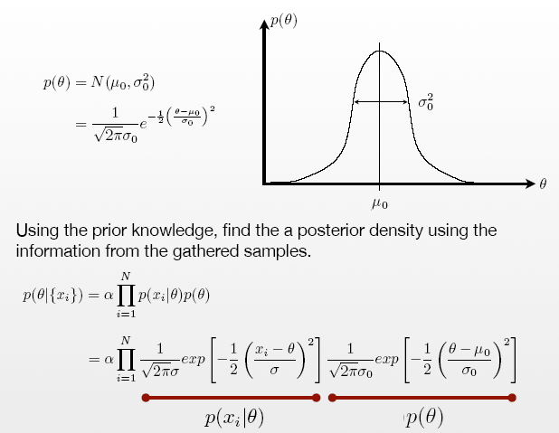
§5.1.3 Bayes Estimation

Slide 29
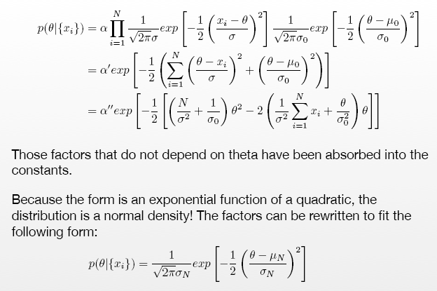
§5.1.3 Bayes Estimation

Slide 30
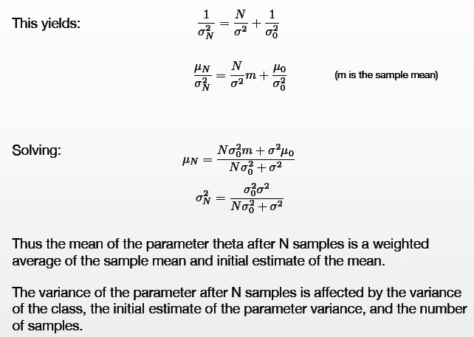
§5.1.3 Bayes Estimation

Slide 31
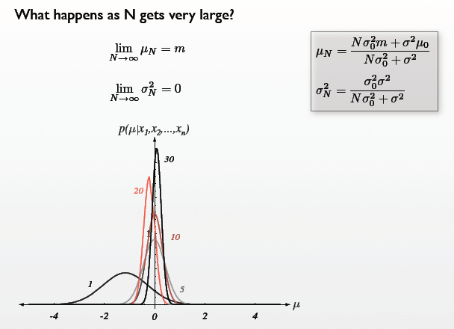
§5.1.3 Bayes Estimation

Slide 32
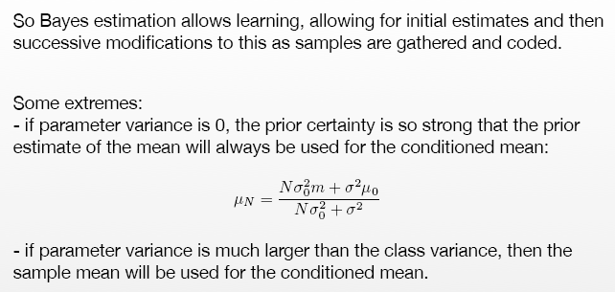
§5.1.3 Bayes Estimation
σ₀=0
σ₀»σ

Slide 33
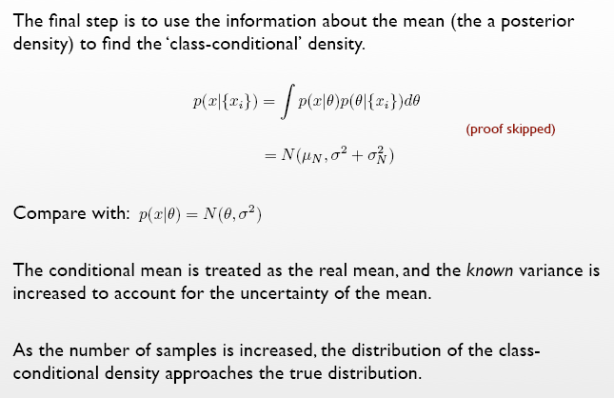
§5.1.3 Bayes Estimation

Slide 34
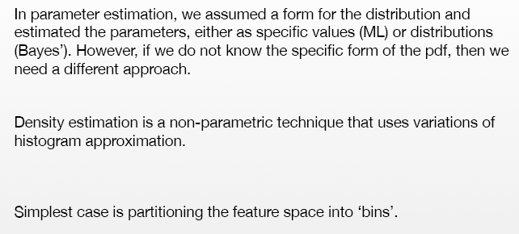
§5.2 Non-Parametric Estimation

Slide 35
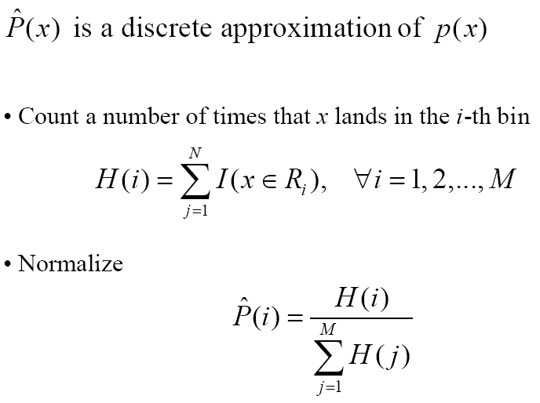
§5.2.1 Histogram Estimation

Slide 36
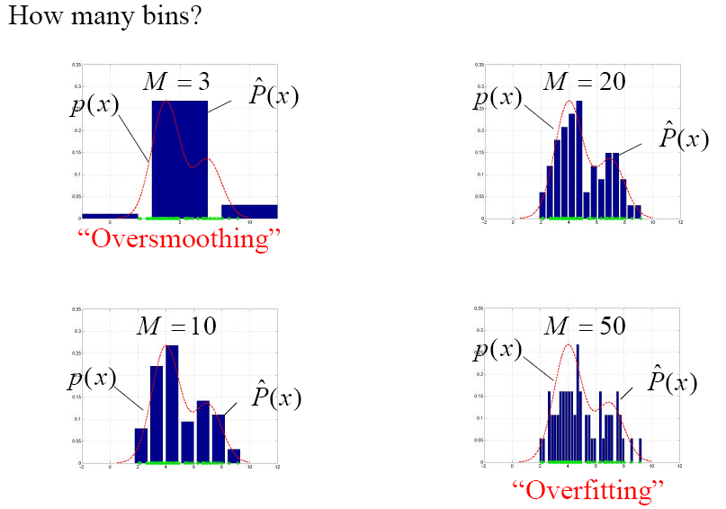
§5.2.1 Histogram Estimation

Slide 37
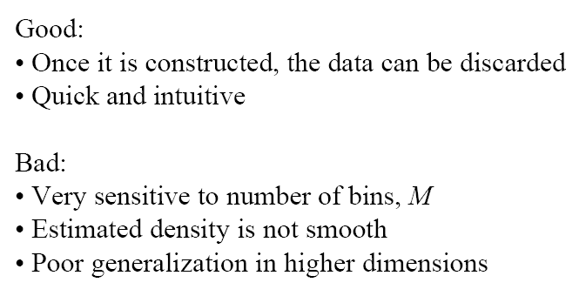
§5.2.1 Histogram Estimation

Slide 38
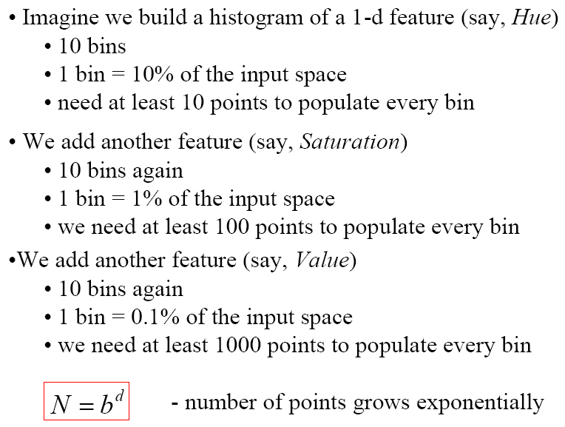
§5.2.1 Histogram Estimation

Slide 39
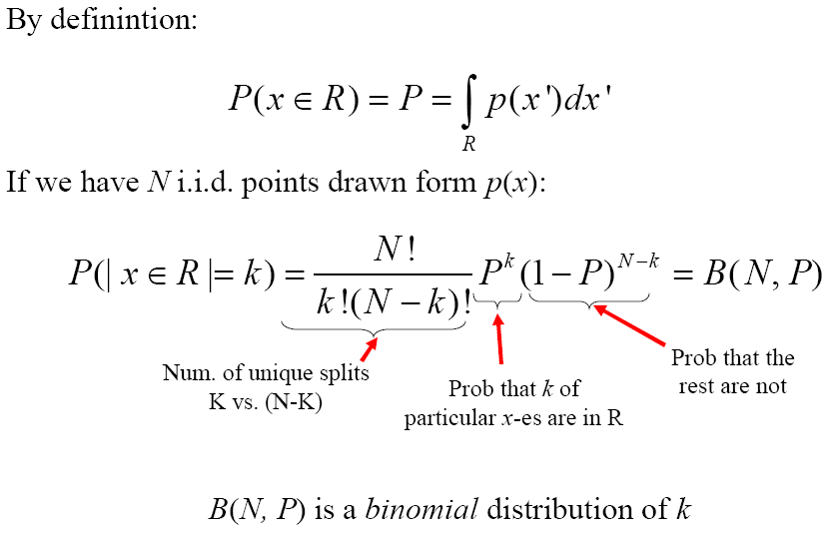
§5.2.1 Histogram Estimation

Slide 40
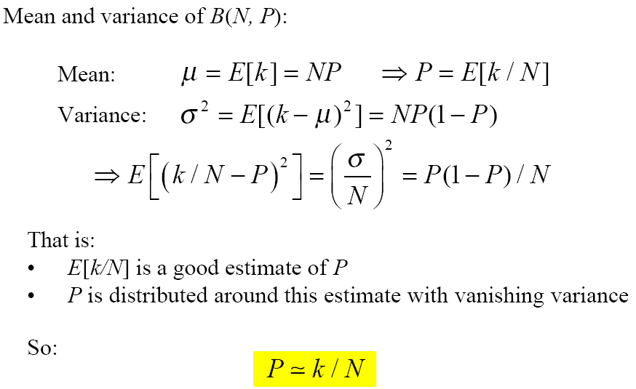
§5.2.1 Histogram Estimation

Slide 41
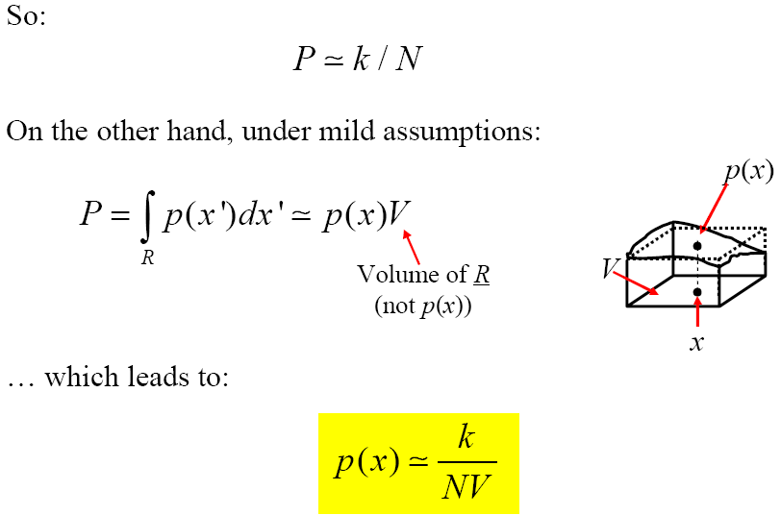
§5.2.1 Histogram Estimation

Slide 42
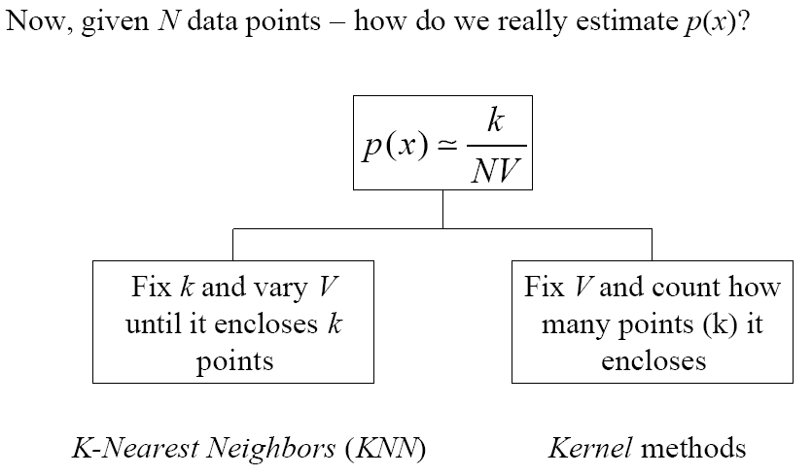
§5.2.1 Histogram Estimation

Slide 43
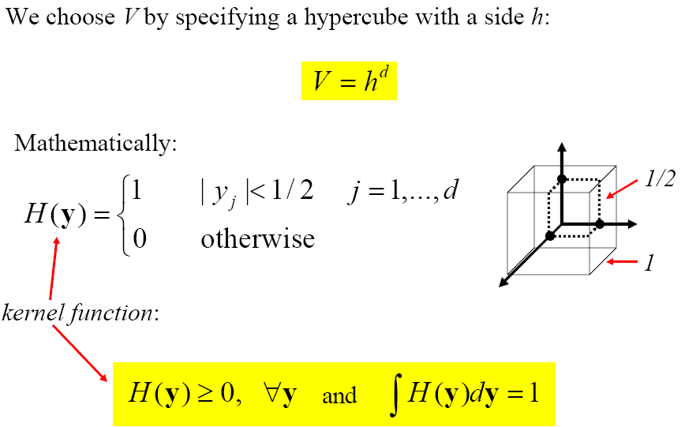
§5.2.2 Parzen Window Estimation (Kernel)

Slide 44
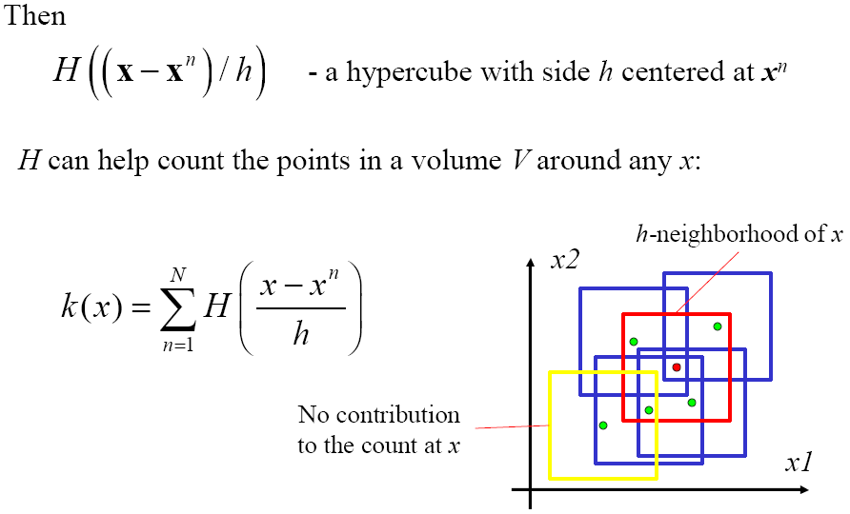
§5.2.2 Parzen Window Estimation

Slide 45
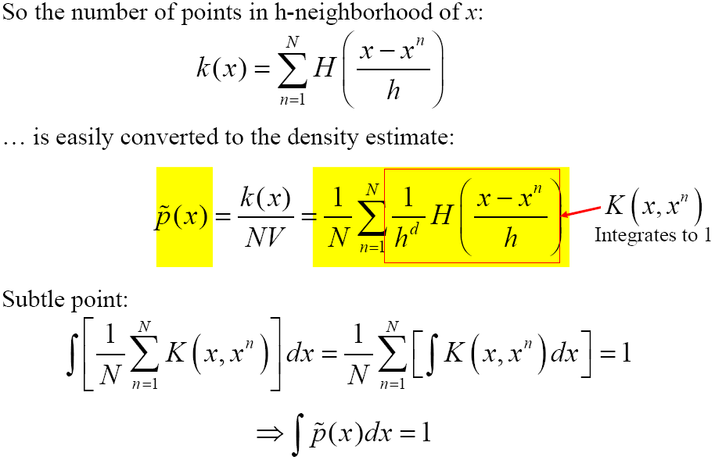
§5.2.2 Parzen Window Estimation

Slide 46
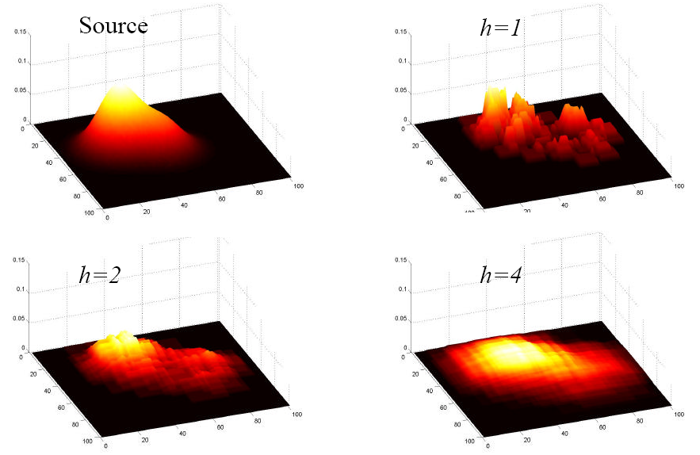
§5.2.2 Parzen Window Estimation

Slide 47
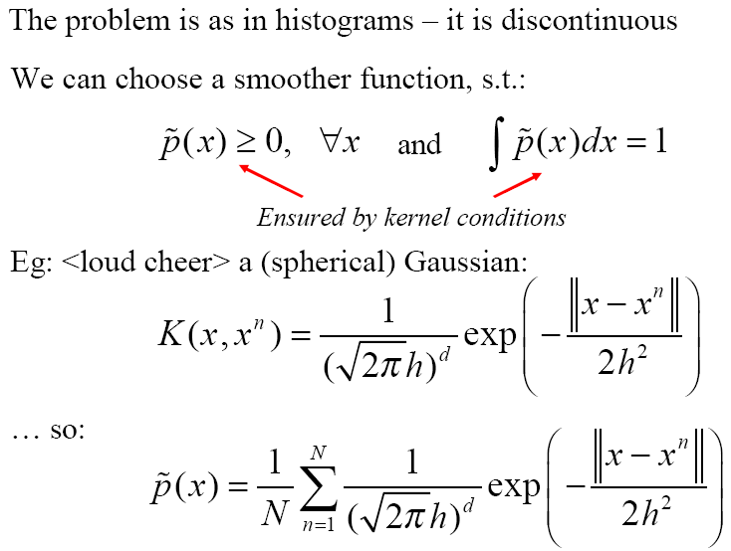
§5.2.2 Parzen Window Estimation

Slide 48
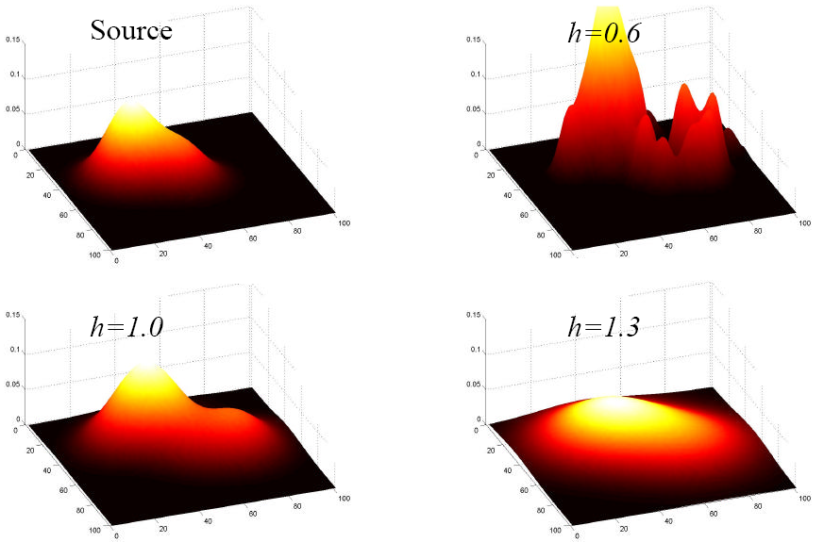
§5.2.2 Parzen Window Estimation

Slide 49
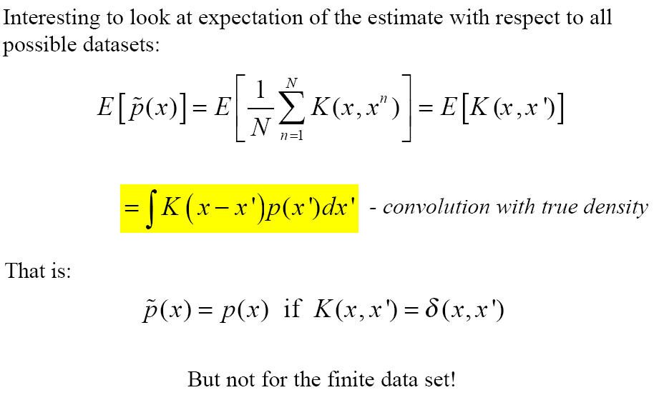
§5.2.2 Parzen Window Estimation

Slide 50
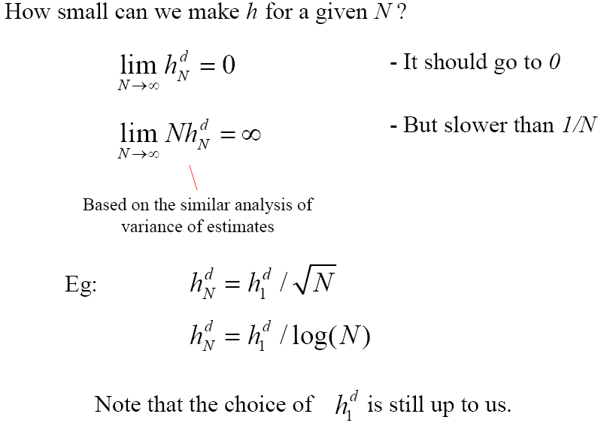
§5.2.2 Parzen Window Estimation

Slide 51
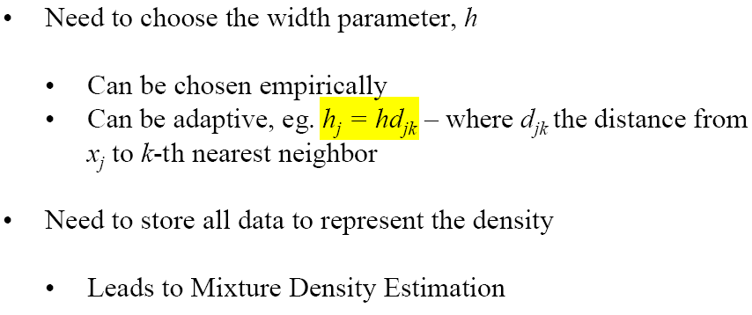
§5.2.2 Parzen Window Estimation

Slide 52

§5.2.3 k_{N}-Nearest-Neighbour Estimation

Slide 53

§5.2 Non-Parametric Estimation

Slide 54
Team Presentation
The focus of this year's presentation is the use of Statistics and Computational Intelligence Methods for classification or clustering. Each group (at most 4 persons) is to select two of the approaches (one belongs to statistics method, another belongs to computational intelligence method) listed below, search the literature for recent articles on their use for classification or clustering, study them and prepare a presentation.
The projects will be implementation (or use) of two (or more) method(s) from the selected approach and testing on artificial and real data set.

Slide 55
Team Presentation
Statistics (Traditional) Approaches:
√ Minimum Euclidean Distance (MED) Classifier
√ Minimum Intra-Class Distance (MICD) Classifier
√ The Bayesian Classifier
√ The Maximum A Posteriori Probability (MAP) Classifier
√ The Maximum Likelihood (ML) Classifier
√ k-Nearest Neighbor (KNN) Classifier
√ Decision Tree
√ Partitioning Clustering Algorithms
√ Hierarchical Clustering Algorithms
√ Density-Based Clustering Methods
√ Grid-Based Clustering Methods

Slide 56
Team Presentation
Computational Intelligence Approaches:
√ The Backpropagation Algorithm (BP)
√ Radial Basis Function Networks (RBF)
√ Support Vector Machines (SVM)
√ Self-Organizing Maps (SOM)
√ Adaptive Resonance Theory (ART)
√ Swarm Intelligence (ANT or PSO)
√ Fuzzy Theory

Slide 57

Team Presentation
The artificial data set:
e.g. 2D4C data set: containing four standard 2D-Gaussian distributed clusters of 50 patterns each. The mean vectors are [0.2, 0.2]^{T}, [0.2, 0.8] ^{T}, [0.8, 0.2] ^{T}, and [0.8, 0.8] ^{T} . variances are all equal to 0.1.
The real data set:
(1) Iris Data set (from UCI) containing 3 classes of 150 instances total in a 4 dimensional space.
(2) Wine Data set (from UCI) containing 3 classes of 178 instances total in a 13 dimensional space.

Slide 58
Team Presentation
Each group will give a presentation on the classification or clustering approach they studied and the results of testing their method(s) on the data and some conclusions. Presentations will be 20-25 minutes using powerpoint. A copy of report should not exceed 20 pages of write up. Code listing can be added in Appendix. Each presentation should include the following:

Slide 59
Team Presentation
Brief review of literature on the methods of the selected Classification or Clustering.
Description of the methods selected for implementation.
Implementation: Data structures used, program structures, data representation.
Testing: test cases using your own and the provided data sets and evaluation the performance.
Discussion of results and conclusions: it is very important to provide a discussion on the use of the methods selected and discuss their suitability and/or limitations for the application.
References.

Slide 60
Project Report
The focus of the project is the research problems such as Statistical Pattern Recognition, Syntactic Pattern Recognition. Each student is to select one of the projects, search the literature for recent articles, study them and submit an report documenting his/her work on the project. Each project report should not exceed 8000 words of write up. The report should include the following:
Title
Abstract
Keywords
Introduction
Main Parts (Body)
Discussion (Conclusion)
References

